Slide 1

QUEUES
LINEAR DATA STRUCTURE
BSCS 3rd Semester Morning
Dr. Farhan Shafiq

Slide 2
Introduction
It is a linear data structure
Queue is an abstract data structure that is similar to STACK.
Unlike Stack it is open at both ends.
One end is used to Insert data.
The other end is used to remove data.

Slide 3
What is a Queue?
A Queue is a FIFO (First In First Out) data structure where the element that is added first will be deleted first.
Queue is a linear data structure where the first element is inserted from one end called REAR and deleted from the other end called as FRONT.

Slide 4
Front points to the beginning of the queue and Rear points to the end of the queue.
In a queue, one end is always used to insert data (enqueue) and the other is used to delete data (dequeue), because queue is open at both its ends.

Slide 5
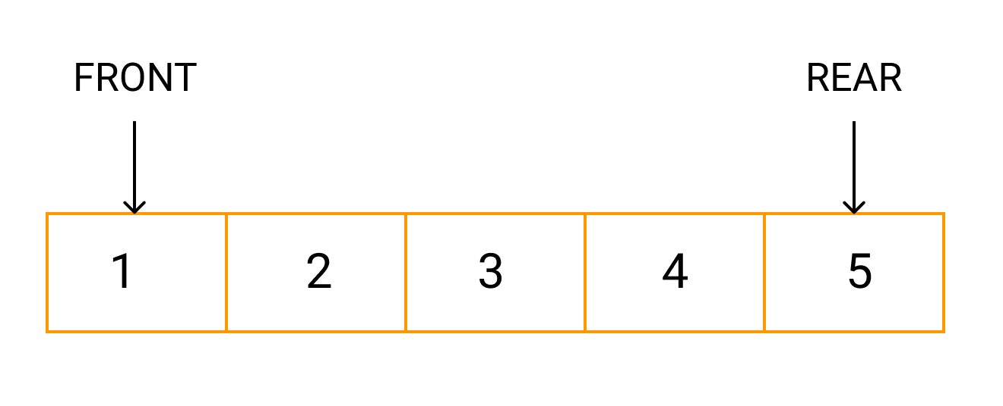
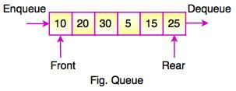
Representation

Slide 6
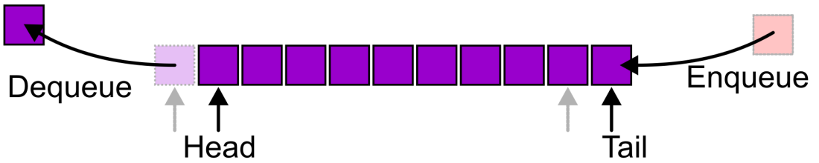
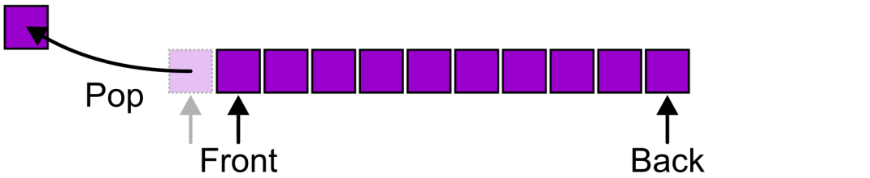
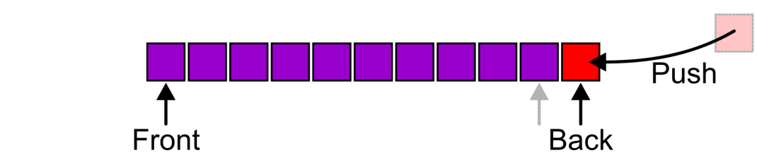
Alternative Terms
Alternative terms may be used for the four operations on a queue, including:
Head for FRONT
Tail for REAR
Push for Enqueue
POP for Dequeue
PUSH
POP

Slide 7
Basic features of Queue
Like stack, queue is also an ordered list of elements of similar data types.
Queue is a FIFO( First in First Out ) structure.
Once a new element is inserted into the Queue, all the elements inserted before the new element in the queue must be removed, to remove the new element.

Slide 8
Operations on Queues
Operations | Description
enqueue() | This function defines the operation for adding an element into queue.
dequeue() | This function defines the operation for removing an element from queue.
init() | This function is used for initializing the queue.
Front | Front is used to get the front data item from a queue.
Rear | Rear is used to get the last item from a queue.

Slide 9
Applications of QUEUE
The most common application is in client-server models
  Multiple clients may be requesting services from one or more servers
  Some clients may have to wait while the servers are busy
  Those clients are placed in a queue and serviced in the order of arrival

Slide 10
In real life scenario, Call Center phone systems uses Queues to hold people calling them in an order, until a service representative is free.
Grocery stores, banks, and airport security use queues
Handling Questions after class in Q&A session uses queues (First-come, First-Serve)

Slide 11
Serving requests on a single shared resource, or computer service (servers) use queues.
like a printer [single shared resource]
CPU task scheduling [single shared resource]
  Web, file, ftp, database, mail [shared Services]

Slide 12
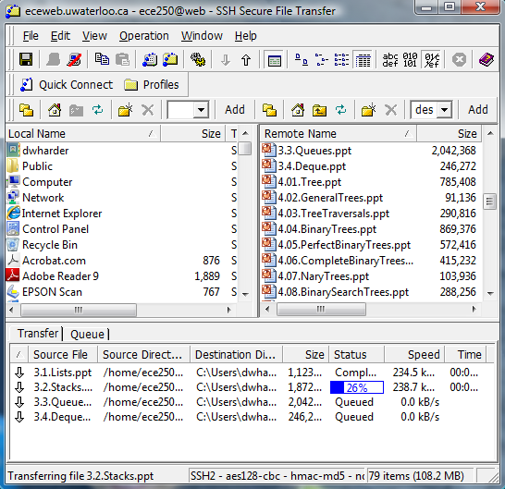

Slide 13
Queue Implementations
There are different methods to implement queue in programming.
The easiest way to implement queue is using Array.
Queues can also be implemented using STACK and Linklist.

Slide 14
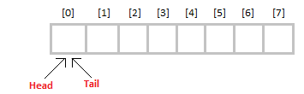
Initially the head(FRONT) and the tail(REAR) of the queue points at the first index of the array (starting the index of array from 0).

Slide 15
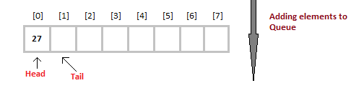
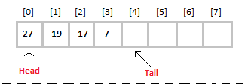
As we add elements to the queue, the tail keeps on moving ahead, always pointing to the position where the next element will be inserted, while the head remains at the first index.

Slide 16
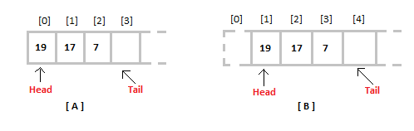
When we remove an element from Queue, we can follow two possible approaches (mentioned [A] and [B] in below diagram).

Slide 17
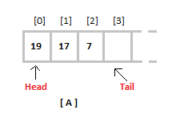
In [A] approach, we remove the element at head position, and then one by one shift all the other elements in forward position.

Slide 18
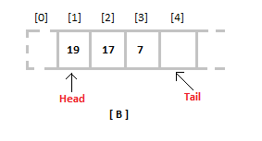
In approach [B] we remove the element from head position and then move head to the next position.

Slide 19
What is the difference?
In approach [A] there is an overhead of shifting the elements one position forward every time we remove the first element.
In approach [B] there is no such overhead, but whenever we move head one position ahead, after removal of first element, the size on Queue is reduced by one space each time.

Slide 20
Algorithms for QUEUE Operations
Algorithm for ENQUEUE operation
Check if the queue is full or not.
If the queue is full, then print overflow error and exit the program.
If the queue is not full, then increment the tail and add the element.

Slide 21
Algorithm for DEQUEUE operation
Check if the queue is empty or not.
If the queue is empty, then print underflow error and exit the program.
If the queue is not empty, then print the element at the head and increment the head.

